Slide 1

Recommendations to enhance profitability
Presented by Sneha Mishra

Slide 2
Recommendations
Offboard Restaurants w/ Negative Profit Margin
Set a Minimum of 10% Commission Percentage
Eliminate the 10% Discount

Slide 3
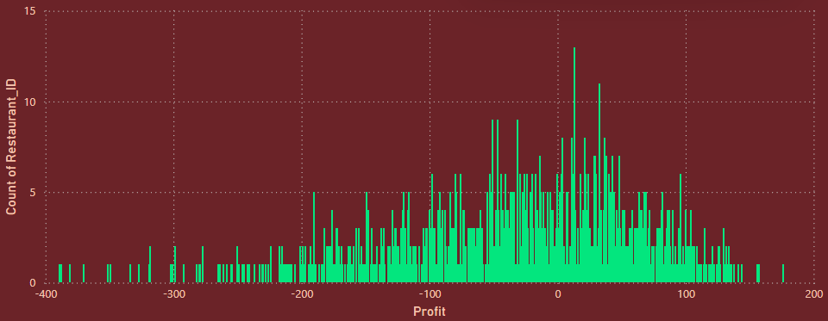
63% of our restaurant partnerships are unprofitable.
Out of our 621 partner restaurants, only 225 generate profits for us.
We have identified that a significant percentage of our restaurant partners are currently contributing to financial losses. To enhance our overall profitability and ensure sustainable growth, it is advisable to consider offboarding these partners. This strategic move will allow us to focus our resources on more profitable partnerships and improve our financial health.

Slide 4

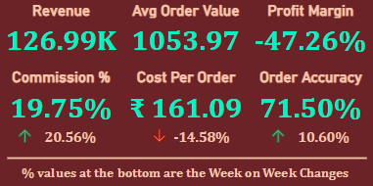
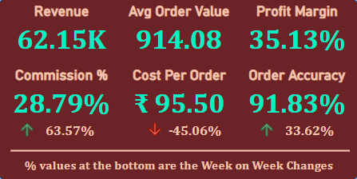

Current Metrics
Enhanced Metrics

Slide 5
Current Metrics
Enhanced Metrics
This act catapults our loss ridden business into a profit generation. An increase in the profit margin, implies a bigger percentage of the revenue generated is retained by the business.
The Profit increases by a whopping 166%.
The Profit Margin grown by 82.4%.
The Commission % has risen by 9%.
The Cost Per Order dropped by 41%.
The Order Accuracy improved by 20.3%.

Slide 6
Recommendations
Offboard Restaurants w/ Negative Profit Margin
Set a Minimum of 10% Commission Percentage
Eliminate the 10% Discount

Slide 7
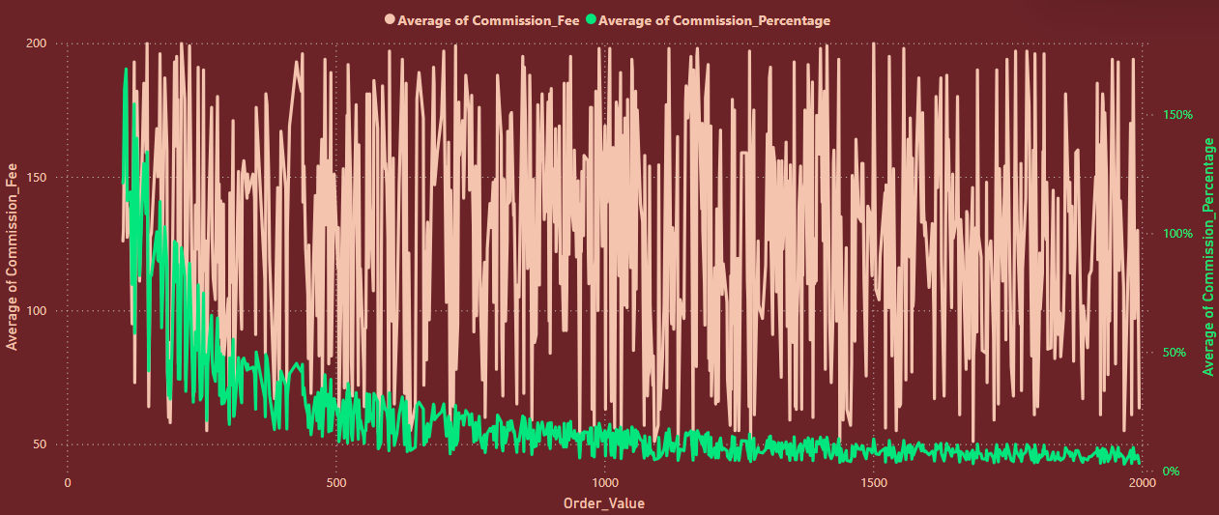
The commission percentage drops sharply as the order value increases, whilst the commission Fee is all over the place with respect to order value
This highlights a need for making Commissions as percentage of Order Value instead of a flat fee.

Slide 8
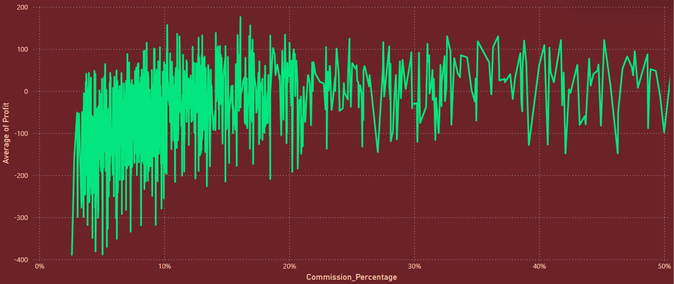
The majority of the loss is incurred when commission percentage is lower than 10%
We should set the Minimum Commission Percentage to be 10% of order value

Slide 9


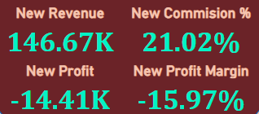

Current Metrics
Enhanced Metrics

Slide 10
Current Metrics
Enhanced Metrics
Setting a minimum commission percentage of 10% can give us a competitive edge, as the industry standard ranges from 15-30%.
The Profit has increased to 57.7%.
The Profit Margin has grown to 31.3%.
The Commission % risen by 19%
The Revenue has increased by 15%.

Slide 11
Recommendations
Offboard Restaurants w/ Negative Profit Margin
Set a Minimum of 10% Commission Percentage
Eliminate the 10% Discount

Slide 12
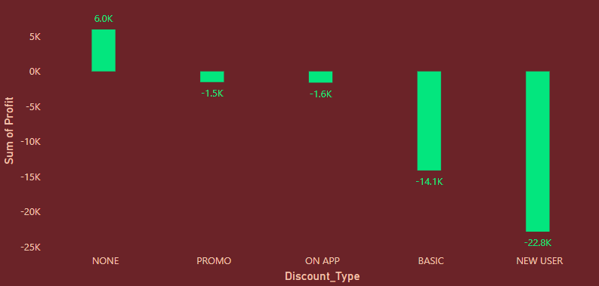
The basic discount results in losses that are ten times more than those associated with the next tier of discounts.
10x more
losses
To attract new customers, it is essential to maintain our new user discount. Thus, to improve our profitability, we recommend phasing out the basic discount.

Slide 13
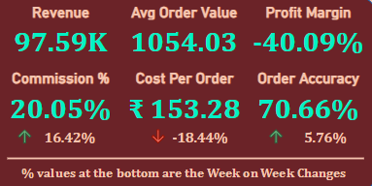

Current Metrics
Enhanced Metrics

Slide 14
Current Metrics
Enhanced Metrics
By optimizing our discount strategy, we can remain competitive in the market. Offering targeted discounts that are financially viable helps us stand out without eroding our profit margins.
The Profit has increased by 41%.
The Profit Margin has risen by 15%.
The Commission Percentage has gone up by 1.5 percentages.
The Cost Per Order dropped by 5%

Slide 15
Cumulative Impact of all the suggestions
The collective enhancement of the profitability of the food delivery service by the recommendations made

Slide 16

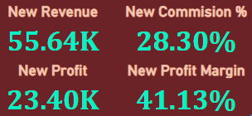

Current Metrics
Enhanced Metrics

Slide 17
Current Metrics
Enhanced Metrics
The individual impact by the suggested recommendations, compound when we merge them, creating a sustainable business model for the delivery service
The Profit has grown by 1.7 times.
The Profit Margin increased by 88.4%.
The Commission % has risen by 8.6%.
The Cost Per Order dropped by 43%.

Slide 18
Thank you for viewing!

